Slide 1
BME 790 Spring 2017 Weekly Summary
Author: Daniel A Hagen
Week: 02/13/17-02/19/17
Relevant Topics: Kinematic locomotion, directional linearity, linearity, nonholonomic constraints, Pfaffian constraints and connection vector fields

Slide 2
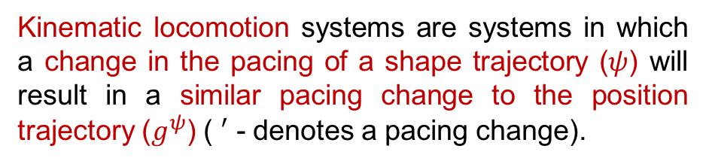
Kinematic Locomotion
Locomotion is defined informally as the process of using reaction forces to turn internal shape parameters into external position changes. As a system changes shape, it may be subject to restrictions (e.g., velocity constraints, momentum conservation laws, drag forces) that will produce these reaction forces that dictate the movement of the body frame.
Moreover, kinematic locomotion systems exhibit a configuration dependent, directionally linear relationship between the shape velocity and the induced position velocity. Linearity is addressed in the following slides but briefly, it means that every position velocity is a linear function of shape velocity.
where
Many engineering/biological systems are fully linear, where the configuration is sufficient to describe the linear relationship between position and shape velocities.
Kinematic locomotion systems are systems in which a change in the pacing of a shape trajectory ($ψ$) will result in a similar pacing change to the position trajectory ($g^{ψ}$) ( $′$ - denotes a pacing change).

Slide 3

(Directional) Linearity
Formally, a system is directionally linear if each element in the output space is a linear function of the input vector space (1) along each line passing through the origin (2).
Linearity is a special case of directional linearity in which all of the “slopes” of the azimuths passing through the origin are also linearly related.
(where $ℳ$ is a matrix that multiplies a to get b)
Note that the system on the top right fails (1) as the relationship is not linear and the system on the bottom right, although linear, fails (2) as its vectors are not the same through the origin.

Slide 4
Symmetry
Informally, symmetry can be defined as some action that, once performed, leaves the starting and ending configurations indistinguishable. This concept of “action” is closely related to mathematical groups. In fact, the group of symmetrical actions must meet the same four criteria that any group must meet.
Identity: objects are trivially symmetric when no action is performed (null action).
Inverse: any symmetry-preserving action may be undone.
Closure: any two symmetry-preserving actions can be combined to make a third.
In a uniform environment, the dynamics of many locomotor systems are symmetric with respect to the position/orientation of the body frame. Therefore, we can relate a symmetric linear-kinematic locomotor system’s body velocity to its shape position/velocity.
Associativity: the order in which consecutive symmetry-preserving actions are performed does not matter.

Slide 5
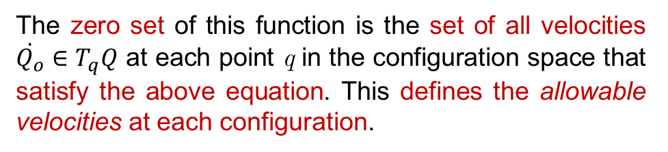
Nonholonomic Constraint
A nonholonomic constraint restricts the velocity with which a system can move without restricting the accessible configurations. Officially, it is a (possibly time varying) function c on the systems configuration bundle, TQ.
This system can be thought of as SE(2) with forward, lateral, and rotational movements as the three DOF.
The zero set of this function is the set of all velocities $\dot{Q_{o}}∈T_{q}Q$ at each point q in the configuration space that satisfy the above equation. This defines the allowable velocities at each configuration.
Note that this constraint does not limit where the disk is allowed to move in configuration space, but rather prevents lateral velocity.
A simple example of nonholonomic constraints is a rolling disk that is only allowed to move either forward/backwards or rotate (i.e., it is not allowed to slide sideways).

Slide 6
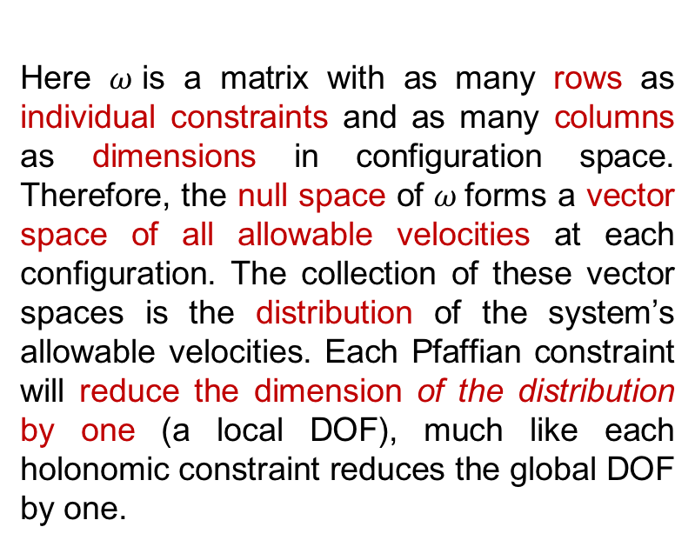
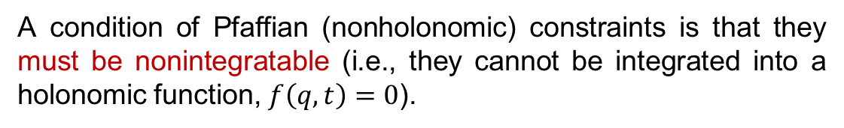
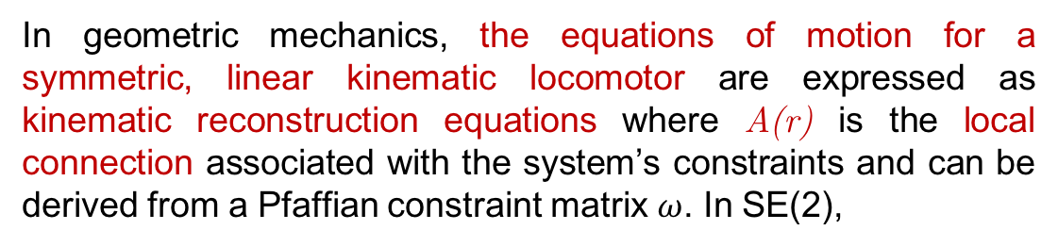
Pfaffian Constraints
It is often useful to list all of the linear nonholonomic constraints of a system together as a matrix of Pfaffian constraints.
A condition of Pfaffian (nonholonomic) constraints is that they must be nonintegratable (i.e., they cannot be integrated into a holonomic function, $f\left(q,t\right)=0$).
In geometric mechanics, the equations of motion for a symmetric, linear kinematic locomotor are expressed as kinematic reconstruction equations where A(r) is the local connection associated with the system’s constraints and can be derived from a Pfaffian constraint matrix $ω$. In SE(2),
Here $ω$is a matrix with as many rows as individual constraints and as many columns as dimensions in configuration space. Therefore, the null space of $ω$forms a vector space of all allowable velocities at each configuration. The collection of these vector spaces is the distribution of the system’s allowable velocities. Each Pfaffian constraint will reduce the dimension of the distribution by one (a local DOF), much like each holonomic constraint reduces the global DOF by one.
where m is the number of individual Pfaffian constraints and n is the number of shape variables. In general, A can be found from:

Slide 7
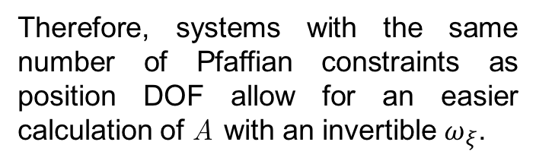
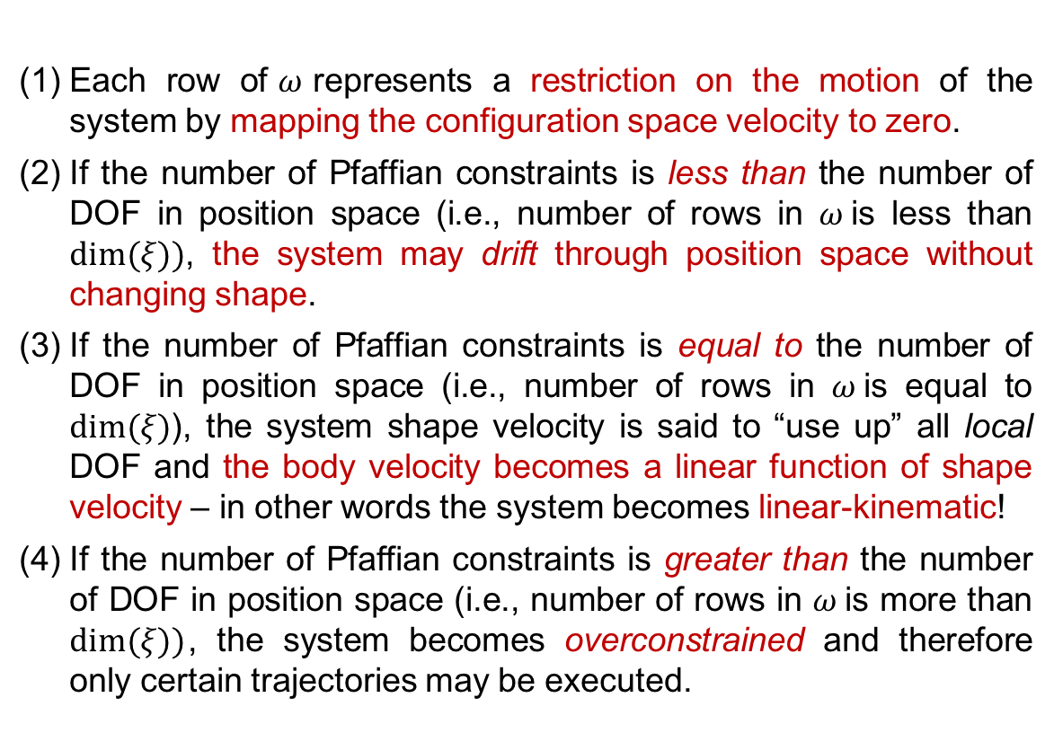
Pfaffian Constraints (cont.)
Some important notes on dimensionality:
If we assume a system in SE(2) with 3 Pfaffian constraints:
Each row of$ω$represents a restriction on the motion of the system by mapping the configuration space velocity to zero.
If the number of Pfaffian constraints is less than the number of DOF in position space (i.e., number of rows in $ω$is less than $dim⁡(ξ))$, the system may drift through position space without changing shape.
If the number of Pfaffian constraints is equal to the number of DOF in position space (i.e., number of rows in $ω$is equal to $dim⁡(ξ)$), the system shape velocity is said to “use up” all local DOF and the body velocity becomes a linear function of shape velocity – in other words the system becomes linear-kinematic!
If the number of Pfaffian constraints is greater than the number of DOF in position space (i.e., number of rows in $ω$is more than $dim⁡(ξ))$, the system becomes overconstrained and therefore only certain trajectories may be executed.
Therefore, systems with the same number of Pfaffian constraints as position DOF allow for an easier calculation of A with an invertible $ω_{ξ}$.

Slide 8

Connection Vector Fields
Connection vector fields are tools used to better understand the effect of Pfaffian constraints on a system. In short, the rows of the Pfaffian matrix (i.e., the constraints) serve as vector field generators. With any shape trajectory, the resulting body velocity will be the dot product of the connection vector and the shape velocity. Derived here are the Pfaffian constraints and connection vector fields for a “differential-drive car”.
These constraints are expressed in frames $g_{1}$ and $g_{2}$ – need to express constraints in overall body frame, $g$.
The (three) resulting constraints expressed in overall body frame velocities are:
Left Wheel Right Wheel
Nonholonomic constraints at wheels:
The local connection A can be viewed as three row vectors.

Slide 9
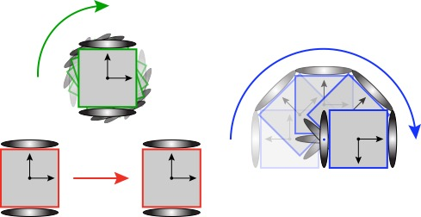
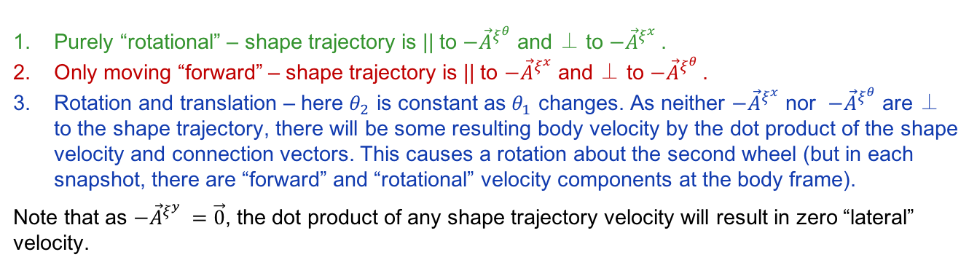
Connection Vector Fields
Purely “rotational” – shape trajectory is || to $−{\vec{A}}^{ξ^{θ}}$ and ⊥ to $−{\vec{A}}^{ξ^{x} }$.
Only moving “forward” – shape trajectory is || to $−{\vec{A}}^{ξ^{x}}$ and ⊥ to $−{\vec{A}}^{ξ^{θ} }$.
Rotation and translation – here $θ_{2}$ is constant as $θ_{1}$ changes. As neither $−{\vec{A}}^{ξ^{x}}$ nor $−{\vec{A}}^{ξ^{θ}}$ are ⊥ to the shape trajectory, there will be some resulting body velocity by the dot product of the shape velocity and connection vectors. This causes a rotation about the second wheel (but in each snapshot, there are “forward” and “rotational” velocity components at the body frame).
Note that as $−{\vec{A}}^{ξ^{y} }=\vec{0}$, the dot product of any shape trajectory velocity will result in zero “lateral” velocity.

Slide 10
Conclusions/Impressions
Symmetric linear-kinematic systems allow for direct relationships to be made between position and shape with respect to both positions and velocities. But more importantly, linear nonholonomic constraints can be utilized to construct a matrix (Pfaffian constraints) that relates the body-frame velocities to the shape velocities. This allows for analysis to be made on the response of a system to varying shape trajectories when subject to real (physical) constraints on the velocities of the system.
If the number of nonholonomic constraints matches the number of DOF the system is “kinematic” (in that, there are no restrictions on possible configurations). But in the cases where the number of constraints is larger than DOF then the system becomes over-constrained and the allowable trajectories become truncated. This is particularly interesting when considering the allowable “shape trajectories” of constrained variables such as muscle length/velocity, activation, etc.
This analysis, however, becomes more difficult when considering systems with mismatched constraints/DOF as the A matrix derived from the Pfaffian constraints utilizes a symmetric submatrix to simplify its derivation. Therefore pseudo-inverse techniques would be needed for more constrained (and more complex!) systems.

